Slide 1
Employee Management System
Submitted by-
Name – Anuj
UID- 24MCI10020
Section- 24MAM-3A

Slide 2
Introduction…
I made this Employee management project with the help of :
NET BEANS-NetBeans is a Java-based integrated development environment (IDE). NetBeans enables the creation of applications using a set of modular software components known as modules. NetBeans is compatible with Windows, Mac OS X, Linux, and Solaris. It also allows other programming languages to be extended. In addition to Java programming, Third-party developers can expand NetBeans-based applications, including the NetBeans IDE.
JAVA-High-level, Object-Oriented programming language which help programmers to run their applications efficiently. JAVA is the programming language which comes into our minds when we talk about android application. By using JAVA as a programming language, programmer can develop any type of android application easily. JAVA also provides many libraries which also helps in making efficient android application. Swing is a Java GUI widget toolkit. It's part of Oracle's Java Foundation Classes (JFC), which provides an API for creating graphical-user-interfaces for Java programs.
SWING- Swing is a Java GUI widget toolkit. It's part of Oracle's Java Foundation Classes (JFC), which provides an API for creating-graphical-user-interfaces for Java programs. Swing was created to give a more advanced collection of graphical user interface components than the previous Abstract Window Toolkit (AWT). Swing offers a pluggable look and feel that allows applications to have a look &feel that is unconnected to the underlying platform, as well as a look & feel that emulates the look & feel of numerous platforms.
SQL- SQL (Structured Query Language) is a computer language that is used to manage data in a relational database management system (RDBMS) or for stream processing in a relational data stream management system (RDSMS). It's especially beneficial for dealing with structured data, or data that has relationships between entities and variables.

Slide 3
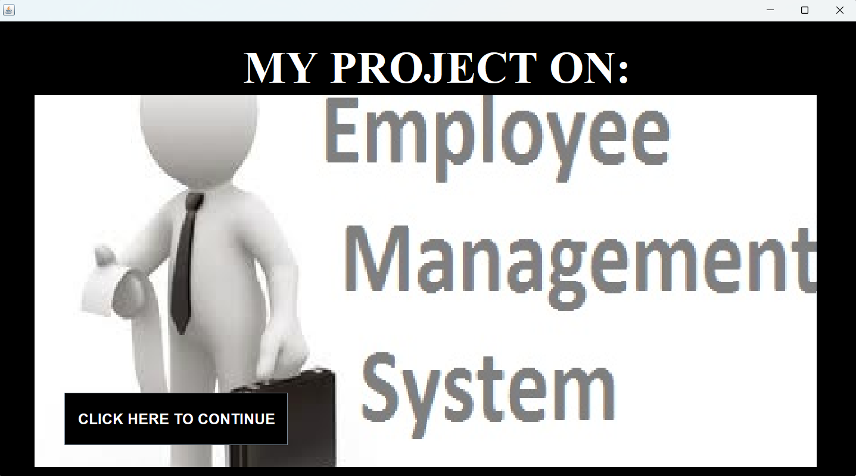
working of the Project
1. Splash Frame- This frame contains the topic of the project and a “click here to continue” button which redirects the page to the login frame.

Slide 4
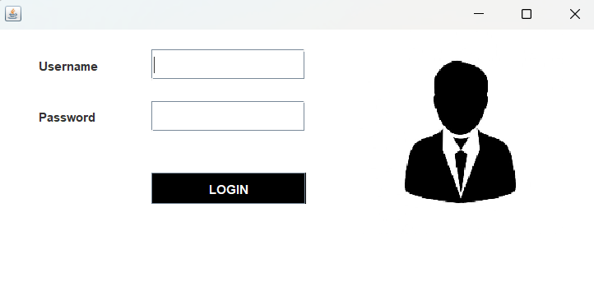

2. Login Frame- This is the login frame of this system where user have to enter the required credentials to have access for the main dashboard.

Slide 5
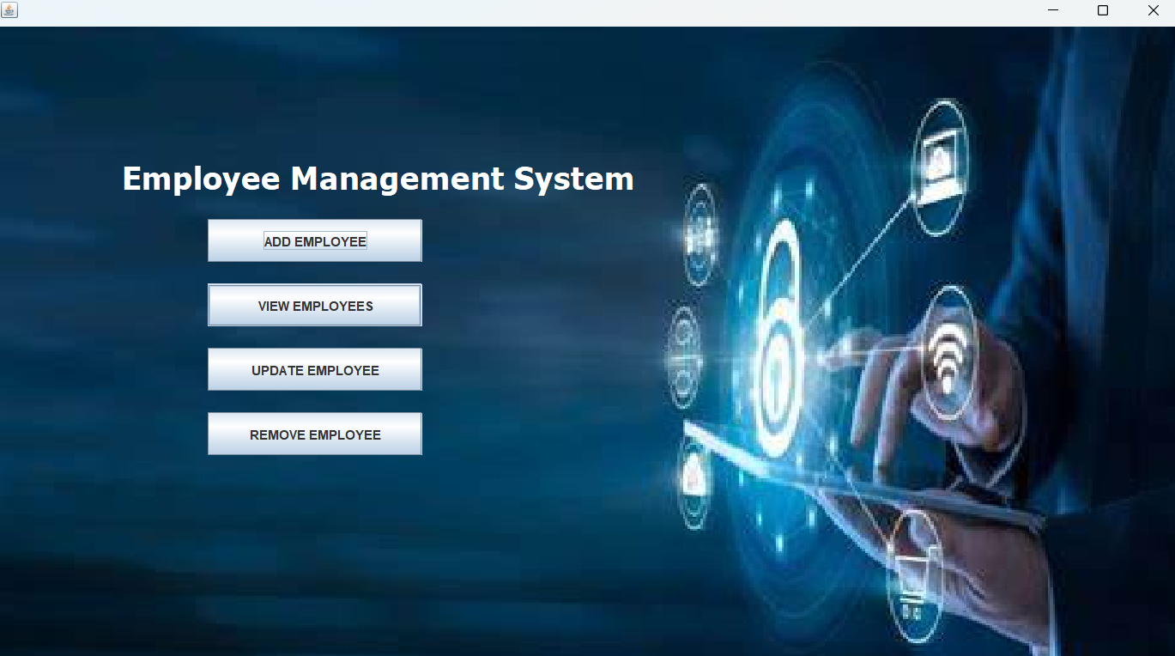
3. Main Dashboard- After login in, user is directed to the main dashboard of this system where user can perform various operations like adding an employee, viewing an employee, updating an employee, and deleting an employee.

Slide 6
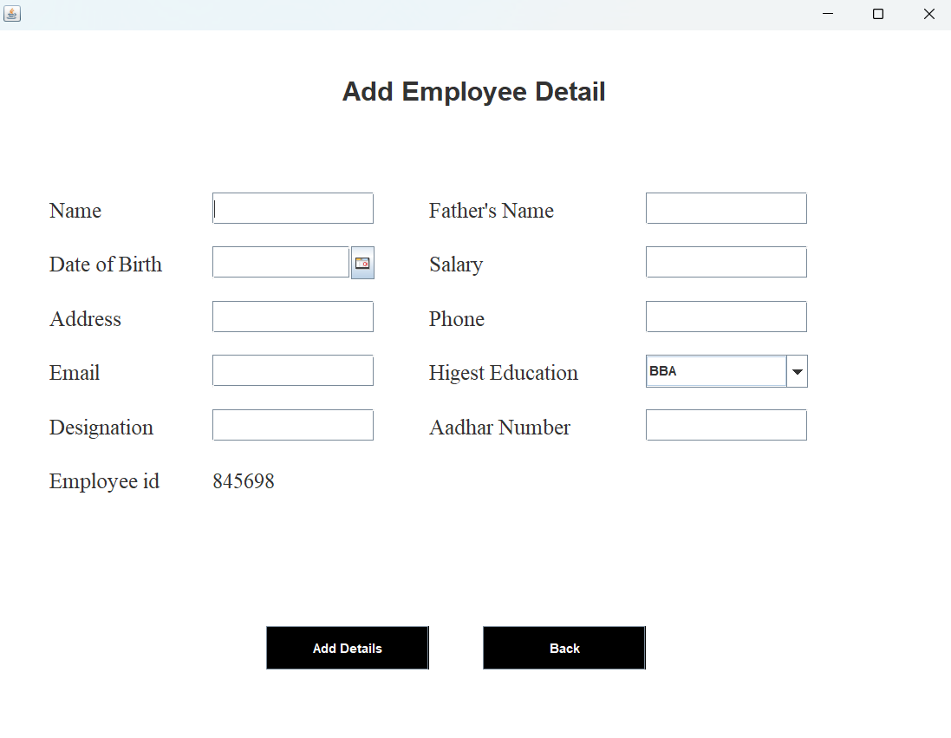
4. Add Employees- Here user have to enter all the required credentials to add a new employee to the system.

Slide 7
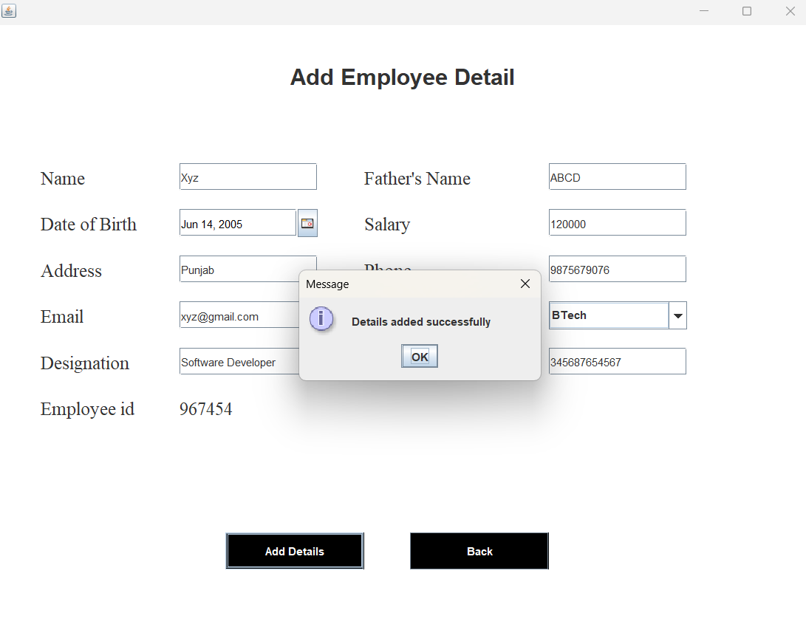
After adding the details:

Slide 8
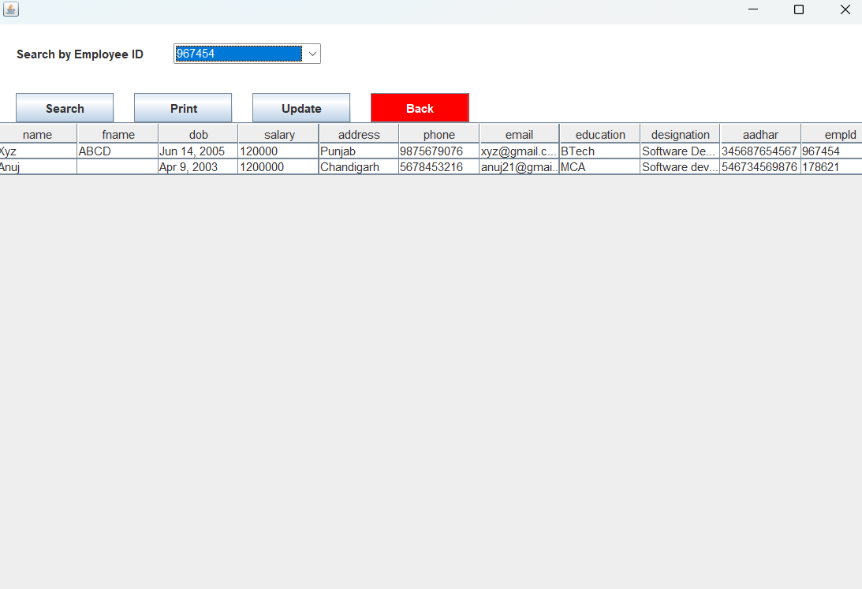
5. View Employees- User can view all the stored employee’s information.

Slide 9
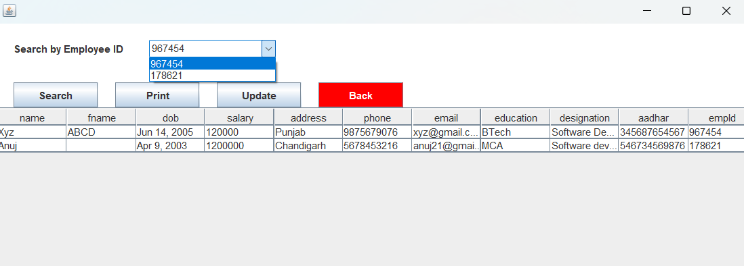
6. Update Employees- User can update the employee details by selecting the Employee id by clicking on the dropdown box in the view employee frame.

Slide 10
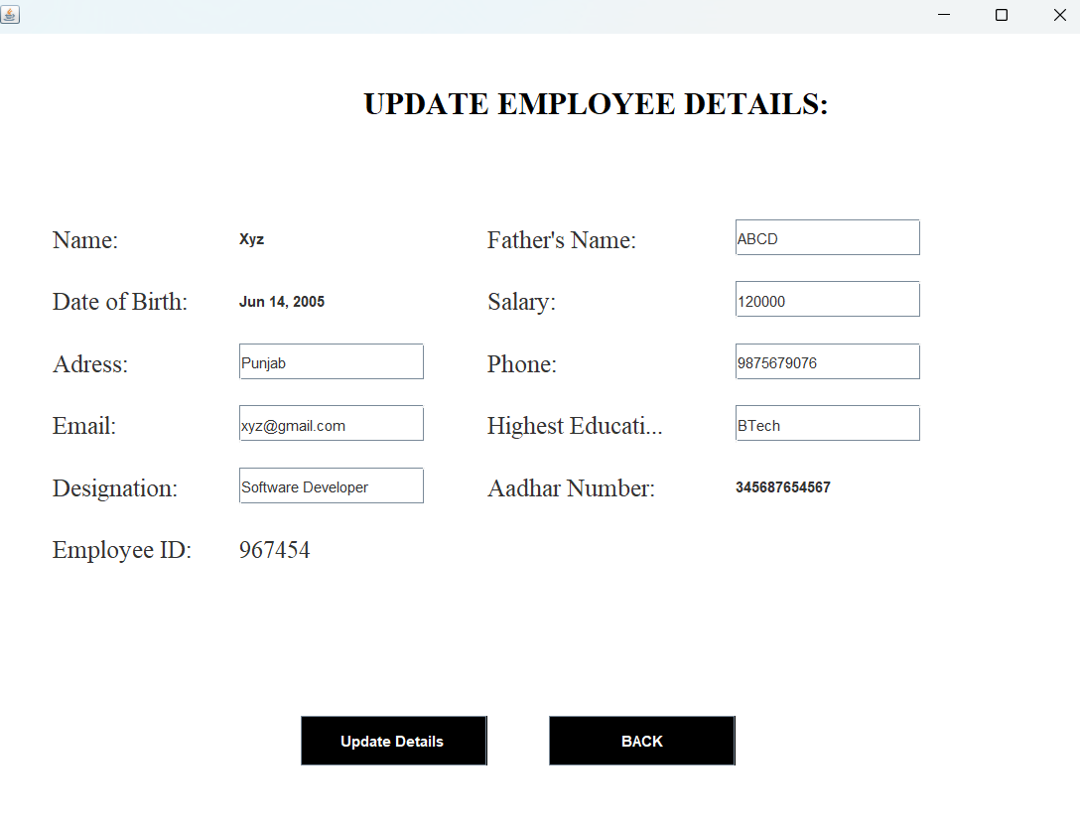
After selecting the Employee ID for updating:

Slide 11
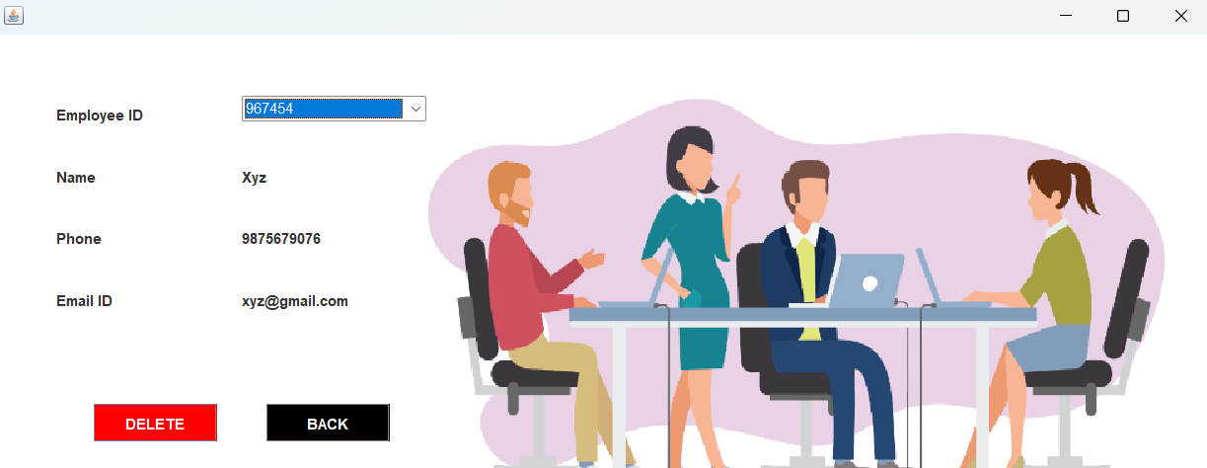
7. Remove Employee- User has to select the employee id in order to delete his information from the system.

Slide 12
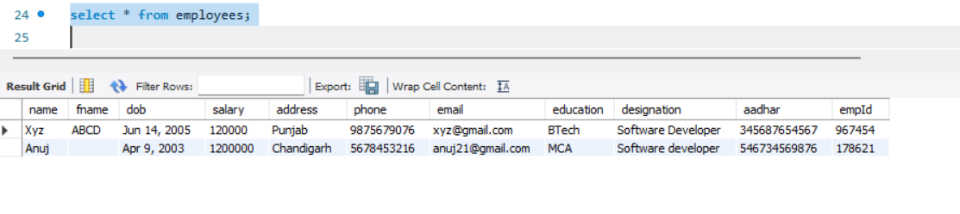
Connectivity using MySQL- It has provided this whole projects connection with the MySQL database which shows all the details stored in it.
i) Login Page-This stores the login credentials such as Username and Password to login a user. ii) Add Employee-This stores the details of every added employee in a table.

Slide 13
Conclusion…
The goal of the initiative is to digitize personnel databases in businesses and provide administrators access to computers. Employees and administrators use software as an information system. The user can store his or her database safe and secure for an indefinite amount of time here. Adding, deleting, accessing, and changing employee information is simple and easy using the Employee Management System.

Slide 14
Thank You…
GitHub Link for my Project:
https://github.com/anujdhiman28/Employee-Management-System-.github

